Slide 1

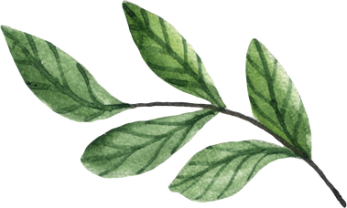


Nature
Activity
Cards

Slide 4

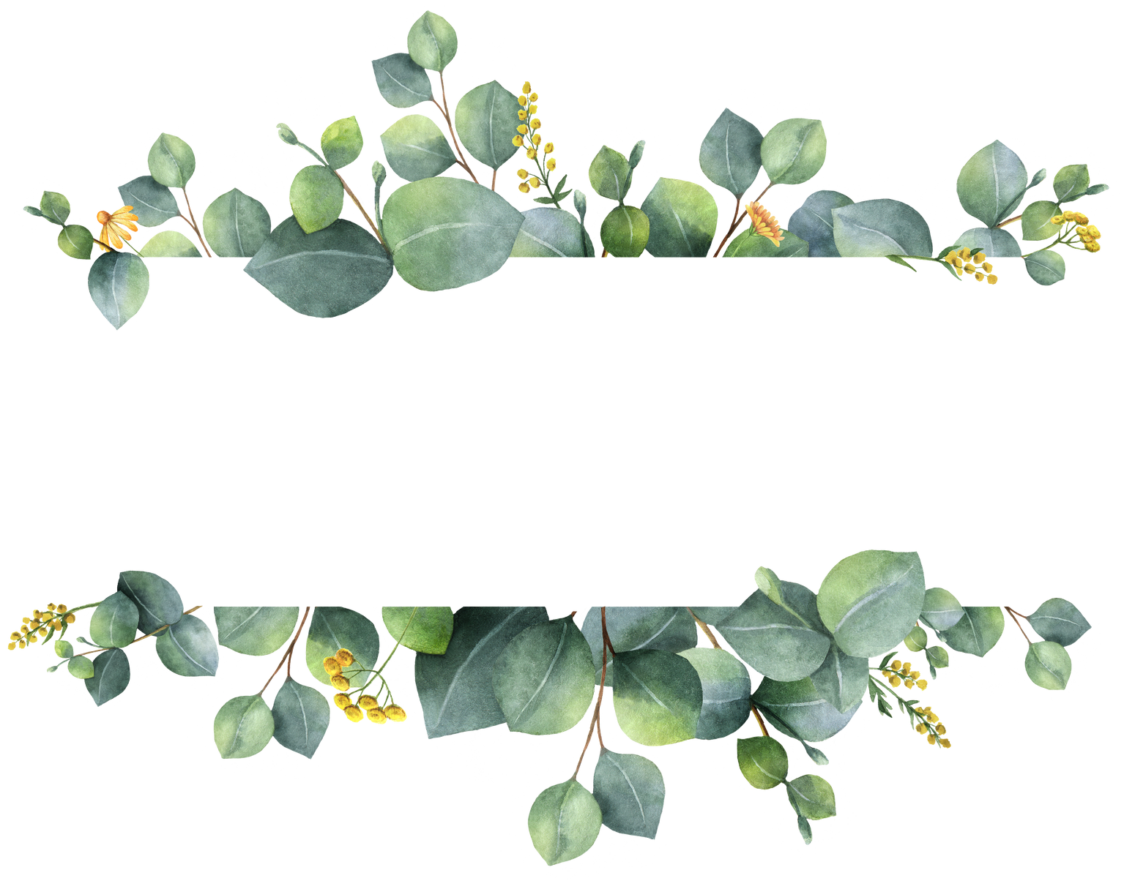
1. Nature Walks
Take a mindful stroll during tutor time. Absorb your surroundings using all your senses. What can you see, hear, smell, and feel?
Record your experiences through writing, sketches, or photography.

Slide 6
2. Nature Journaling
Add to your nature journals. Write freely about your experiences, observations, thoughts, and feelings. Document changes over time and reflect on the patterns of nature.

Slide 8
3. Nature Mapping
Create a map of the school grounds, marking areas where you observe wildlife, plants, and insects.
Use apps like Merlin and Seek to identify species.
Draw, photograph, and label your discoveries.

Slide 10
4. Patterns in Nature
Explore the natural patterns around you. Where do you see spirals, symmetry, or fractals?
Use the Ouisi cards for inspiration. Capture these patterns through drawings, collages, or photography.

Slide 12
5. Nature Scavenger Hunt
Plants & Trees
A leaf with more than 5 points
A flower with a bright colour
A tree with textured bark
A plant with a distinctive smell
A seed or seed pod
Moss growing on a tree or stone
A fern or ivy vine

Slide 14
5. Nature Scavenger Hunt
Wildlife
A bird singing or calling
An insect on a leaf or flower
A spider’s web
A squirrel or small mammal
A butterfly or moth
A feather on the ground
Animal tracks or footprints

Slide 16
5. Nature Scavenger Hunt
Natural Features
A smooth, round stone
A muddy puddle or damp patch of earth
A log or fallen branch
A patch of lichen on a rock or tree
A nest or burrow (observe from a distance!)
A flowing stream or puddle reflecting the sky

Slide 18
5. Nature Scavenger Hunt
Sounds and Smells
The rustling of leaves in the wind
A bird's call or song
The buzzing of an insect
The scent of pine or damp earth
The sound of water flowing
Smell of wildflowers, blossom or trees

Slide 20
5. Nature Scavenger Hunt
Bonus Challenges
Something heart-shaped in nature
Two types of fungi (take a photo — don’t touch!)
A leaf with visible veins
A cloud shaped like an animal
A natural material that could make a sound (e.g., a hollow log or dry leaves)
A four-leafed clover

Slide 22
6. Nature Reading
Share your favourite nature-themed books. Where is your ideal spot to read outside? Consider making a tutor class reading list and reviewing your favourites.

Slide 24
7. Birdwatching
Set up a simple bird feeder outside your classroom.
Keep a diary of the birds using a Bird Identifier book or app. Draw or photograph your feathered visitors.

Slide 26
8. Cloud Gazing
Lie on the grass, relax, and watch the clouds drift by.
What shapes and images can you see? Record your interpretations through drawings, stories, or poems.

Slide 28
9. Nature Soundscape
Discover the sounds of nature. Can you make music using natural materials like sticks, stones, or seed pods?
Compose a short piece or write a song inspired by what you hear.

Slide 30
10. Wildflower Identification
Explore the school grounds and identify local wildflowers.
Use a wildflower guide or app like Seek. Press flowers to add to your portfolio or sketch them in a nature journal.

Slide 32
11. Nature Storytelling
Create a short story inspired by something you’ve observed in nature. It could be a fable, a fantasy, or even a nature documentary script. Illustrate your story for your portfolio.

Slide 34
12. Mini Nature Documentary
Use your device to create
a 2-3 minute mini documentary about a specific plant, insect, or animal you observe.
Add narration or text to describe your findings.

Slide 36
13. Bug Hotel Build
Construct a simple bug hotel using natural materials like sticks, leaves, and bark.
Place it in a sheltered area and monitor which creatures visit. Document your findings.

Slide 38
14. Eco Pledge
As a group, create a nature-themed eco pledge. What small changes can you make to support the environment?
Write and illustrate your pledge and display it in
your classroom.

Slide 40
15. Star Gazing
On a clear evening, spend time outside observing the night sky. Identify constellations and track the phases of the moon.
Record your observations and research the stars.

Slide 41
COMPETITION
CARDS

Slide 42
Photography Competition
Time to get creative! Run a nature photography competition in your class and vote on your top five to enter the School wide competition as your class representatives.

Slide 43
COMPETITION
CARDS

Slide 44
2. MK Poet Laureate
Are you our first poet laureate? We are looking for a poet to create a poem to celebrate the launch of Mount Kelly Nature, to use throughout the project.
Is it you?

Slide 45
COMPETITION
CARDS

Slide 46
3. Sunflower Growing
Time to test those green fingers. Please look after your sunflower seedling, nurture it and watch it grow. We are hoping to decorate the marquee for Founders Day with Sunflowers, with prizes for the tallest.

